Slide 1


Slide 2
5.2: Using Linked Lists
CS2308
Gentry Atkinson

Slide 3
When are Linked Lists Useful?
Linked List
Insertion and deletion is cheap.
Can hold any number of elements.
Access is expensive.
Array
Easy to create. Easy to delete.
Access is easy.
Re-sizing arrays is expensive.

Slide 4
Searching a Linked List
This is an application of Task 4: Traverse the list.
Move a pointer along list nodes until one contains the target value.
Reaching a NULL next pointer indicates the end of the list.
This is Sequential Search.

Slide 5
Sorting a Linked List
Bubble sort and Selection sort work on linked lists.
BUT, let’s think about Insertion sort.
  Inserting into a linked list is much cheaper than inserting into an array.
  Insertion sort (for every value, find the right position) is a reasonable choice for linked lists.

Slide 6
Example 1
void selectionSort(Node* head)
{
//from: https://www.geeksforgeeks.org/iterative-selection-sort-for-linked-list/
Node* temp = head;
while (temp != NULL) {
Node* min = temp;
Node* r = temp->next;
while (r) {
if (min->val > r->val)
min = r;
r = r->next;
}
int x = temp->val;
temp->val = min->val;
min->val = x;
temp = temp->next;
}
} //This is a lazy solution

Slide 7
Types of linked lists
Singly linked:
  each node points to the next
Doubly linked:
  each node points to the next and the previous
Circular:
  the tail node points back to the head
We use singly linked in this class.

Slide 8
Building a Linked List Class
So far we have been building linked lists using raw access to Nodes.
We could write a LinkedList class to control access to the nodes in the list.
We could also offer our users a simpler interface to avoid hard-coding the 11 “tasks” every time we need them.

Slide 9
What Should a linked list do?
Insert a value.
Delete a value.
Check if the list is empty.
Print the list.
Search for a value in the list.
Delete the list.

Slide 10
Example 2
class LinkedList{
private:
class Node{
public:
int val;
Node* next;
Node(int v){val = v;next = NULL;}
};
Node* head;
Node* tail;
public:
void insert(int v);
void del(int v);
bool isEmpty();
void printList();
bool searchList(int v);
void delList();
LinkedList(){head=NULL;tail=NULL;}
~LinkedList(){delList();}
};

Slide 11
Insert
If head is NULL, we need to create a new Node at the head.
Otherwise, we will create a new node following the tail node, and then shift the tail pointer to point at the new node.

Slide 12
Example 3
void LinkedList::insert(int v){
if(head==NULL){
head = new Node(v);
tail = head;
}
else{
tail->next = new Node(v);
tail = tail->next;
}
}

Slide 13
Delete
Traverse the list looking for a Node with a matching value, with leading and following pointers.
If we reach the end, do nothing.
If the first Node needs to be deleted, set head to head→next.
If the tail node needs to be deleted, set tail to the following pointer.

Slide 14
Example 4
void LinkedList::del(int v){
Node* leading = head;
Node* following = NULL;
while(leading->val != v){
following = leading;
leading = leading->next;
if(leading == NULL) return;
}
if(leading == head)
head = head->next;
else if(leading == tail){
tail = following;
tail->next = NULL;
}
else
following->next = leading->next;
delete leading;
}

Slide 15
Is the list empty?
Return true if head is NULL.
Return false otherwise.

Slide 16
Example 5
bool LinkedList::isEmpty(){
return head==NULL;
}

Slide 17
Print the list
Traverse the list.
Print the val of every Node.
Halt when you reach a NULL value when following next pointers.

Slide 18
Example 6
void LinkedList::printList(){
Node* temp = head;
while(temp != NULL){
cout << temp->val << ' ';
temp = temp->next;
}
cout << endl;
}

Slide 19
Search for a value
Traverse the list.
Return true if we find a Node with a matching value.
Return false if we reach the end (NULL).

Slide 20
Example 7
bool LinkedList::searchList(int v){
Node* temp = head;
while(temp != NULL){
if(temp->val == v) return true;
temp = temp->next;
}
return false;
}

Slide 21
Delete the list
Every node in the list is dynamically allocated, so we need to delete all of them.
Move the head pointer down the list with a following pointer behind it.
Use the following pointer to delete each node.
Set head and tail to NULL.
Why can this function change head?

Slide 22
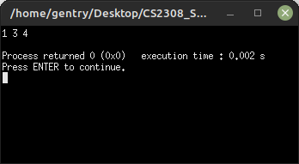
Test Run 1
int main(int argc, char** argv){
LinkedList myList;
myList.insert(1);
myList.insert(2);
myList.insert(3);
myList.insert(4);
myList.del(2);
myList.printList();
} //try to guess the output

Slide 23
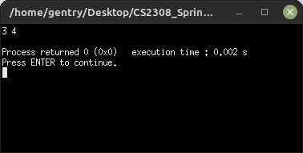
Test Run 2
int main(int argc, char** argv){
LinkedList myList;
myList.insert(1);
myList.insert(2);
myList.delList();
myList.insert(3);
myList.insert(4);
myList.printList();
} //try to guess the output

Slide 24
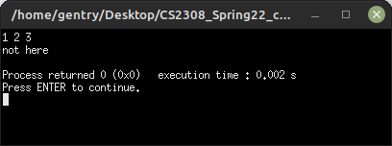
Test Run 3
int main(int argc, char** argv){
LinkedList myList;
myList.insert(1);
myList.insert(2);
myList.insert(3);
myList.printList();
if (myList.searchList(5))
cout << "found it" << endl;
else
cout << "not here" << endl;
} //try to guess the output

Slide 25
Shallow Copying vs. Deep Copying
We can create a new pointer to point to the head of a list.
If two pointers point to the same list, we call this a “shallow” copy. Traversing either list will print the same values, but changing one also changes the other.
Deep copying means creating new Nodes with the same values.

Slide 26
Shallow Copying vs. Deep Copying
Head 1
Head 2
Head 1
Head 2
3
3
3
3
3
3
2
2
2
7
7
7
NULL
NULL
NULL

Slide 27
Questions or Comments?

